Slide 1


Methods and Applications

Slide 2


Applications of machine learning
Self-driving cars
Synthetically-Generated Faces

Slide 3






How do we recognize a prediction problem?
We identify our input and choose a desired output
[CAT or DOG]

Slide 4

Breaking down the machine learning design process
This presentation: we will focus on supervised machine learning approaches - we have recorded values for the output!
Identify a prediction problem - what are the inputs and outputs?
Choose a functional form
Use optimization to get to the best version of your model
Evaluate your model’s performance
Beyond this presentation:
Deploy your model
Acquire new data, repeat steps 1-5

Slide 5
Defining a functional form
How do we get from our input to our output? We define a function!
Indicates output is a function of inputs
Output or Target
The weights for each feature - lets us connect inputs to output
The p inputs to the model, or features
Notes:
Example: with a linear regression, we use each input is weighted and summed up to estimate the output
If we have a good linear regression model, we should be able to get a good estimate for the output given the inputs

Slide 6
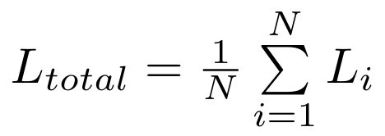
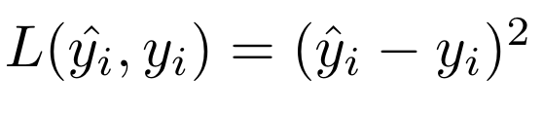
Optimization
How do we find the best version of our function? We define a loss function and try to minimize it!
For a single example:
For the full dataset:
Loss for one observation
Observed value
Loss for the dataset as a whole
The number of training observations
Prediction from the model

Slide 7

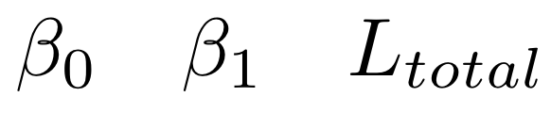
Visualizing Optimization

Slide 8
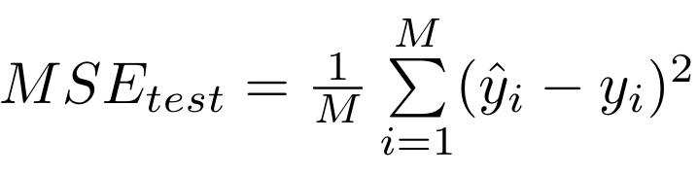
Evaluating our model
Once we’ve fit our model to the data, how do we evaluate its performance? Through metrics!
Mean squared error:
~70%
Training data
Full dataset
Number of test observations
Testing data
~30%

Slide 9
Image Credits
Check out our workshop series site for more learning resources!
Unsplash:
Edgar
Oscar Sutton
Oliur
David Guenther
CHUTTERSNAP
Ksenia Kudelkina
Dimitar Donovski
Pietro Jeng
SAP Insights

